Slide 1
Project Assignment 2
BiteSize
Muhammad Warrad, Rhett Hill

Slide 2
DML QUERIES
Instructions:
- must include ALL queries listed in Queries.sql
- must follow the exact format provided in the template slide

Slide 3
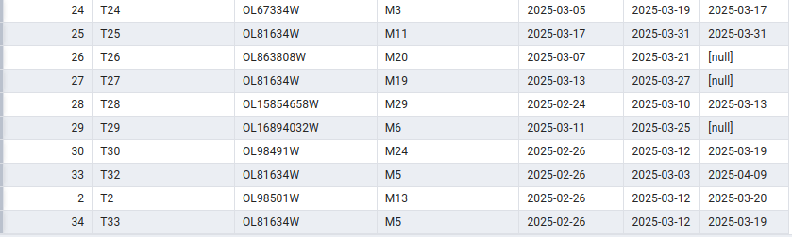
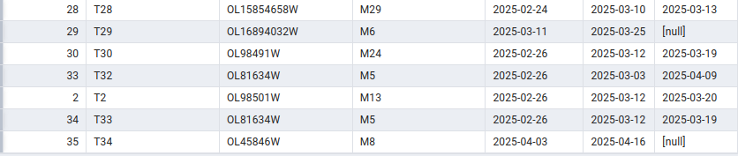
QM2: INSERT DATA
Snapshot of the query output:
Description: Inserts a transaction for a checked out book.
Before
SQL Query:
Insert into Transaction(book_id,member_id,checkout_date,due_date,return_date)
VALUES ('OL45846W', 'M8', '2025-04-03', '2025-04-16', null);
After

Slide 4
QM3: UPDATE DATA:
Snapshot of the query output:
Description: Sets the return date for a transaction
Before
SQL Query:
Update Transaction
set return_date = '2025-04-12'
WHERE transaction_id = 'T34'
After

Slide 5
QM4: DELETE DATA:
Snapshot of the query output:
Description: Deletes a transaction
Before
SQL Query:
Delete from Transaction WHERE transaction_id = 'T34'
After

Slide 6
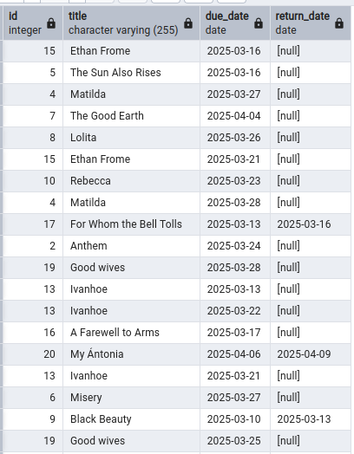
QM5: QUERY DATA WITH WHERE CLAUSE:
Snapshot of the query output:
Description: Returns Books that were either returned late or not returned
SQL Query:
SELECT b.id, b.title, t.due_date, t.return_date
FROM book b JOIN transaction t on b.book_id=t.book_id
WHERE (return_date is null ) OR
( NOT (return_date is null) AND
(return_date - due_date >0)
)

Slide 7
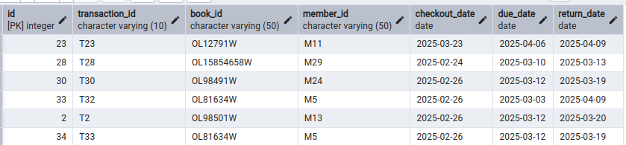
QM6.1: QUERY DATA WITH 'SUB-QUERY IN WHERE CLAUSE
Snapshot of the query output:
Description: Returns all transactions that have an unpaid fine
SQL Query:
SELECT *
FROM transaction
WHERE transaction_id in (SELECT transaction_id FROM fine WHERE is_payed = FALSE)

Slide 8
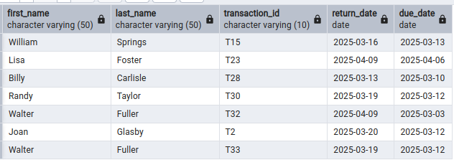
QM6.2: QUERY DATA WITH SUB-QUERY IN FROM CLAUSE
Snapshot of the query output:
Description: Get all members who returned a book late
SQL Query:
SELECT m.first_name, m.last_name, late_returns.transaction_id, late_returns.return_date, late_returns.due_date
FROM (
SELECT transaction_id, member_id, return_date, due_date
FROM Transaction
WHERE return_date IS NOT NULL AND return_date > due_date
) AS late_returns
JOIN Member m ON m.member_id = late_returns.member_id;

Slide 9
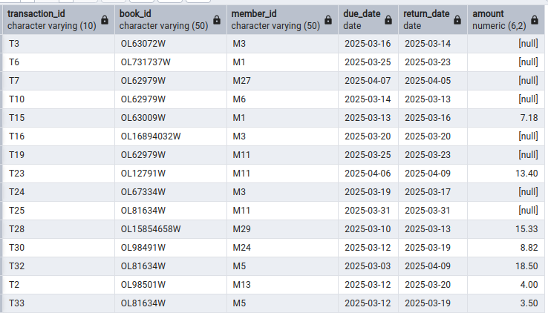
QM6.3: QUERY DATA WITH 'SUB-QUERY IN SELECT CLAUSE':
Snapshot of the query output:
Description: Shows all returning transactions and those who have fines attached to them
SQL Query:
SELECT
t.transaction_id,t.book_id,t.member_id,t.due_date,t.return_date,
(
SELECT f.amount
FROM Fine f
WHERE f.transaction_id = t.transaction_id
)
FROM Transaction t
WHERE t.return_date IS NOT NULL;

Slide 10
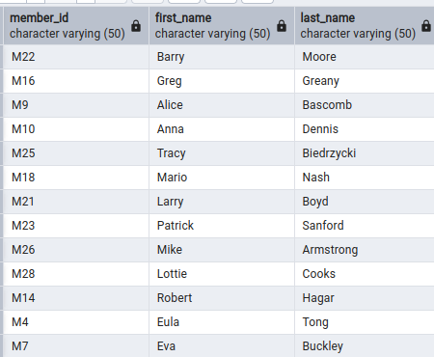
QM7: QUERY DATA WITH EXCEPT
Snapshot of the query output:
Description: Show all members who have not made any transactions
SQL Query:
SELECT m.member_id, m.first_name, m.last_name
FROM Member m
EXCEPT(
SELECT t.member_id, m.first_name, m.last_name
FROM Transaction t join member m on t.member_id = m.member_id
);

Slide 11
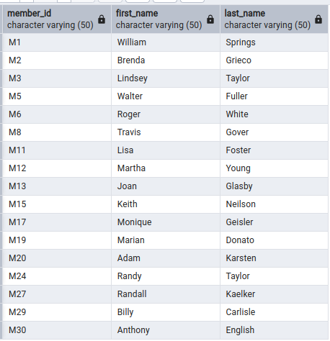
QM8.1: QUERY DATA WITH ANY/SOME
Snapshot of the query output:
Description: Show all members who have made a transaction
SQL Query:
SELECT member_id,first_name,last_name
FROM Member
WHERE member_id = ANY (
SELECT member_id
FROM Transaction
);

Slide 12
QM8.2: QUERY DATA WITH ALL in front of a sub-query
Snapshot of the query output:
Description: Returns the transaction with the highest fine amount
SQL Query:
SELECT book_id, member_id, checkout_date, due_date, return_date, amount, is_payed
FROM Transaction t JOIN fine f ON t.transaction_id = f.transaction_id
WHERE amount >= ALL (
SELECT amount
FROM Fine
);

